Slide 1
Android GUI
Università di Modena e Reggio Emilia
Prof. Nicola Bicocchi (nicola.bicocchi@unimore.it)

Slide 2
Summary
Now that we know the basic elements to create a small working application, let’s go into graphic aspects such as: what objects to show, where to place them, what they should look like
Manifest & Resources
Concepts on screens
Layout & attributes

Slide 3
XML
One of the greatest strengths of Android is the separation of the logic of the application from its appearance. We saw that each activity is associated with an xml file.
The XML language is a markup metalanguage, or a language based on a syntactic mechanism that allows you to define and control the meaning of the elements contained in a document or text. In Android XML files area used to declare our graphical components. This is how Android keeps programming logic and design separate.
<tagName
Attribute:nameAttribute=“values”/>

Slide 4
AndroidManifest.xml
In addition to this, XML is used for an important file that defines all the features of our application: the Android manifest. Is a document that help to know which components are defined in our application. is composed by:
Permission: if our app require permission to use connection from internet, use camera, have access to phone contact read and write data all this permission are declared in it.
Definition of Activites.
Declaration API Level.
Also:
is responsible to protect the application to access any protected parts by providing the permissions.
It lists the instrumentation classes. The instrumentation classes provides profiling and other informations. These informations are removed just before the application is published etc.

Slide 5
Content
<?xml version="1.0" encoding="utf-8"?> <manifest xmlns:android="http://schemas.android.com/apk/res/android" xmlns:tools="http://schemas.android.com/tools" package="com.app">
<uses-permission android:name="android.permission.SEND_SMS"/> <uses-permission android:name="android.permission.INTERNET"/>
<uses-feature android:name="android.hardware.bluetooth" android:required="true"/>
<application android:allowBackup="true" android:dataExtractionRules="@xml/data_extraction_rules" android:fullBackupContent="@xml/backup_rules" android:icon="@mipmap/ic_launcher" android:label="@string/app_name" android:roundIcon="@mipmap/ic_launcher_round" android:supportsRtl="true" android:theme="@style/Theme.CustomToast" tools:targetApi="31"> <activity android:name=".MainActivity" android:exported="true"> <intent-filter> <action android:name="android.intent.action.MAIN" /> <category android:name="android.intent.category.LAUNCHER" /> </intent-filter> </activity> </application> </manifest>
<manifest>: represents the root element of the. It has package attribute that describes the package name that resolves any relative name of class in our package so we can write .NameActivity without having specifying the entire Activity path.

Slide 6
Content
<?xml version="1.0" encoding="utf-8"?> <manifest xmlns:android="http://schemas.android.com/apk/res/android" xmlns:tools="http://schemas.android.com/tools" package="com.app">
<uses-permission android:name="android.permission.SEND_SMS"/> <uses-permission android:name="android.permission.INTERNET"/>
<uses-feature android:name="android.hardware.bluetooth" android:required="true"/>
<application android:allowBackup="true" android:dataExtractionRules="@xml/data_extraction_rules" android:fullBackupContent="@xml/backup_rules" android:icon="@mipmap/ic_launcher" android:label="@string/app_name" android:roundIcon="@mipmap/ic_launcher_round" android:supportsRtl="true" android:theme="@style/Theme.CustomToast" tools:targetApi="31"> <activity android:name=".MainActivity" android:exported="true"> <intent-filter> <action android:name="android.intent.action.MAIN" /> <category android:name="android.intent.category.LAUNCHER" /> </intent-filter> </activity> </application> </manifest>
<manifest>: represents the root element of the. It has package attribute that describes the package name that resolves any relative name of class in our package so we can write .NameActivity without having specifying the entire Activity path.
<permission>: allow us to define permission needed to the application to do its job.

Slide 7
Content
<?xml version="1.0" encoding="utf-8"?> <manifest xmlns:android="http://schemas.android.com/apk/res/android" xmlns:tools="http://schemas.android.com/tools" package="com.app">
<uses-permission android:name="android.permission.SEND_SMS"/> <uses-permission android:name="android.permission.INTERNET"/>
<uses-feature android:name="android.hardware.bluetooth" android:required="true"/>
<application android:allowBackup="true" android:dataExtractionRules="@xml/data_extraction_rules" android:fullBackupContent="@xml/backup_rules" android:icon="@mipmap/ic_launcher" android:label="@string/app_name" android:roundIcon="@mipmap/ic_launcher_round" android:supportsRtl="true" android:theme="@style/Theme.CustomToast" tools:targetApi="31"> <activity android:name=".MainActivity" android:exported="true"> <intent-filter> <action android:name="android.intent.action.MAIN" /> <category android:name="android.intent.category.LAUNCHER" /> </intent-filter> </activity> </application> </manifest>
<manifest>: represents the root element of the. It has package attribute that describes the package name that resolves any relative name of class in our package so we can write .NameActivity without having specifying the entire Activity path.
<permission>: allow us to define permission needed to the application to do its job.
<feature>: allow us to declare hardware and software features to our app needs.

Slide 8
Content
<?xml version="1.0" encoding="utf-8"?> <manifest xmlns:android="http://schemas.android.com/apk/res/android" xmlns:tools="http://schemas.android.com/tools" package="com.app">
<uses-permission android:name="android.permission.SEND_SMS"/> <uses-permission android:name="android.permission.INTERNET"/>
<uses-feature android:name="android.hardware.bluetooth" android:required="true"/>
<application android:allowBackup="true" android:dataExtractionRules="@xml/data_extraction_rules" android:fullBackupContent="@xml/backup_rules" android:icon="@mipmap/ic_launcher" android:label="@string/app_name" android:roundIcon="@mipmap/ic_launcher_round" android:supportsRtl="true" android:theme="@style/Theme.CustomToast" tools:targetApi="31"> <activity android:name=".MainActivity" android:exported="true"> <intent-filter> <action android:name="android.intent.action.MAIN" /> <category android:name="android.intent.category.LAUNCHER" /> </intent-filter> </activity> </application> </manifest>
<manifest>: represents the root element of the. It has package attribute that describes the package name that resolves any relative name of class in our package so we can write .NameActivity without having specifying the entire Activity path.
<permission>: allow us to define permission needed to the application to do its job.
<feature>: allow us to declare hardware and software features to our app needs.
<application>: subitem of the manifest. It includes the namespace declaration, contains several subitem that declares the application component such as activity.

Slide 9
Content
<?xml version="1.0" encoding="utf-8"?> <manifest xmlns:android="http://schemas.android.com/apk/res/android" xmlns:tools="http://schemas.android.com/tools" package="com.app">
<uses-permission android:name="android.permission.SEND_SMS"/> <uses-permission android:name="android.permission.INTERNET"/>
<uses-feature android:name="android.hardware.bluetooth" android:required="true"/>
<application android:allowBackup="true" android:dataExtractionRules="@xml/data_extraction_rules" android:fullBackupContent="@xml/backup_rules" android:icon="@mipmap/ic_launcher" android:label="@string/app_name" android:roundIcon="@mipmap/ic_launcher_round" android:supportsRtl="true" android:theme="@style/Theme.CustomToast" tools:targetApi="31"> <activity android:name=".MainActivity" android:exported="true"> <intent-filter> <action android:name="android.intent.action.MAIN" /> <category android:name="android.intent.category.LAUNCHER" /> </intent-filter> </activity> </application> </manifest>
<manifest>: represents the root element of the. It has package attribute that describes the package name that resolves any relative name of class in our package so we can write .NameActivity without having specifying the entire Activity path.
<permission>: allow us to define permission needed to the application to do its job.
<feature>: allow us to declare hardware and software features to our app needs.
<application>: subitem of the manifest. It includes the namespace declaration, contains several subitem that declares the application component such as activity.
<activity>:for each app component that will be created in our app, we must declare a corresponding XML element in the manifest file. if an activity is not declared and there is reference to use it, the application crash.

Slide 10
Resources

Slide 11
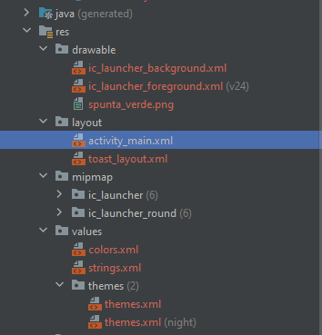
Structure
Resources in android are saved and organized in the root folder named res which contains several sub folders:
layout: it will contain the graphical architecture of the user interface components.
values: will contain strings, colors, dimensions and other types of values that can be used in additional resources or in the Java code. It is important to note that these values will constitute the content of appropriate XML tags (<string>, <dimension>, etc.) grouped in files with the name usually indicative: strings.xml, dimens.xml, colors.xml and so on. Such names are the result of pure convention, but the programmer can freely choose how to call them;
drawable: are images in the most common formats configured in XML;
mipmap: are images that constitute the icon of the application, the one with which it is launched from the operating system.

Slide 12
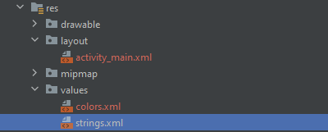
Values: strings
As best practice the text contained in a View: Buttons, TextView, EditView should not be editable directly through the text attribute but defined in a single XML file and edit directly inside it.
<resources> <string name="app_name">MyApp</string> <string name="hello_world">Hello World!</string> </resources>

Slide 13
Values: strings
To avoid:
(activity_main.xml)
<Button
android:id="@+id/button" android:layout_width="wrap_content" android:layout_height="72dp" android:layout_gravity="center_horizontal“
android:text=“click"/>
To do:
(Strings.xml)
<resources> <string name="button_string">click</string> </resources>
(activity_main.xml)
<Button
android:id="@+id/button" android:layout_width="wrap_content" android:layout_height="72dp" android:layout_gravity="center_horizontal“
android:text=“@string/button_string"/>

Slide 14
Access Resources
Resources are compiled in a binary format and indexed with a unique ID. These IDs are stored in a Java class, named R, automatically generated with each change. By identifiers, the resources are accessible both from Java code and from other resources defined in XML:
Java: R.resource_type.resource_name;
R.id.button;
XML: @resource_type / resource_name.
@string/button_string

Slide 15
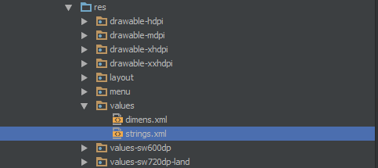
Alternative Resources
Almost every app should provide alternative resources to support specific device configurations. For instance, you should include alternative drawable resources for different screen densities and alternative string resources for different languages. During runtime, Android detects the current device configuration and loads the right resources for your application.
To create new resource folder, we can name: <resources_name>-<qualifier>.
<resources_name>: directory name of the corresponding default resources such as: values, drawable, mipmap, themes exc.
<qualifier>:name that specifies an individual configuration for which these resources are to be used such as: Language (en,fr,en),resolution(hdpi,mdpi,xhdpi,xxhdpi)

Slide 16
Concepts on screens

Slide 17
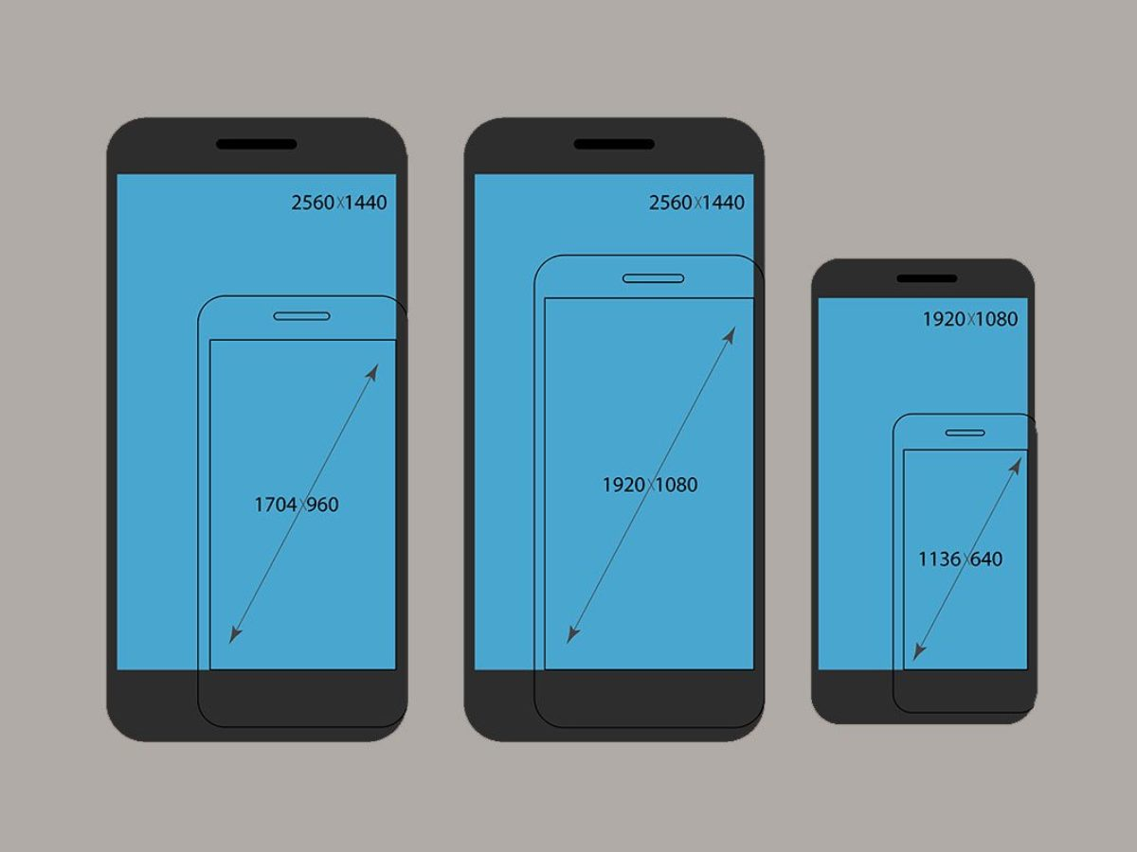
Screen Size
To show in our applications components such as Buttons, TextView and images it is important to understand with which measures are defined.
When we talk about screen size we talk about physical size measured along diagonal, we have 4 general sizes: small, normal, large and extra large.

Slide 18
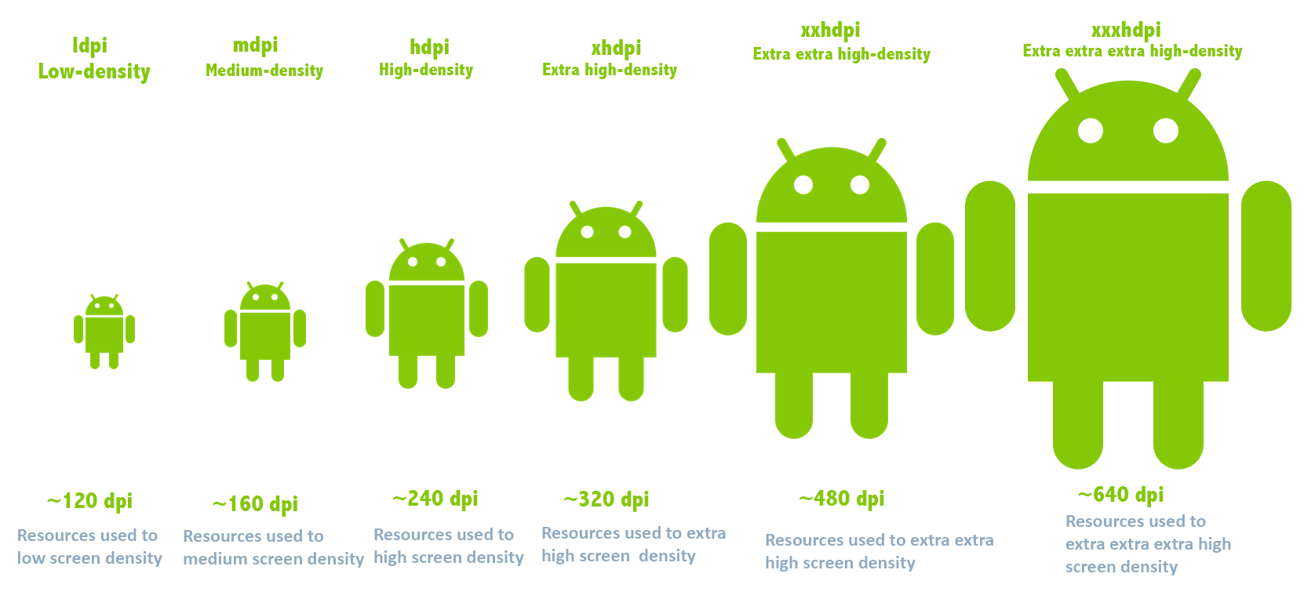
Screen Density
Number of pixels in an inch known as dpi (dots per inch) or ppi (pixels per inch).
There are 4 main categories:
ldpi: low density per inch
mdpi: medium density per inch
hdpi: high density per inch
xhdpi: extra high density per inch.
Every android device has different density size.

Slide 19
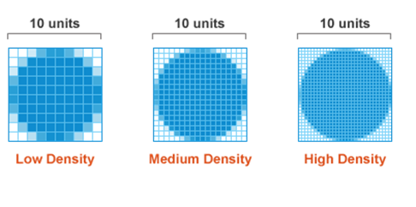
Screen Density
1 inch on low density we have 10 pixel
1 inch on medium density we have 20 pixel
1 inch on high density we have 30 pixel
if we use pixels as base unit, we must manage the difference density and different screen sizes
ex: 10 pixels are perfectly on ldpi, the mdpi is half size of screen and hdpi is ¼ of the screen.

Slide 20
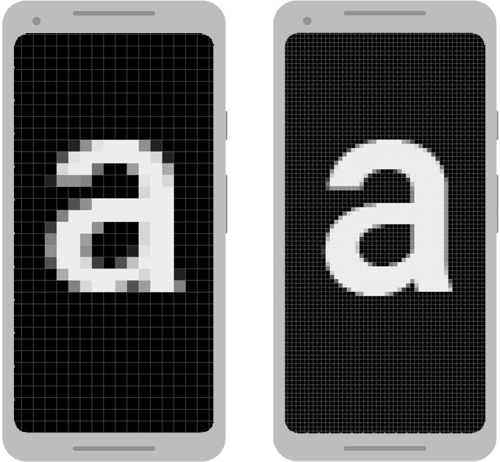
Issue: using pixels
Pixel are a minute area of illumination on a display screen, one of many from which an image is composed.
Defining dimensions with pixels is a problem because different screens have different pixel densities, so the same number of pixels may correspond to different physical sizes on different devices.

Slide 21
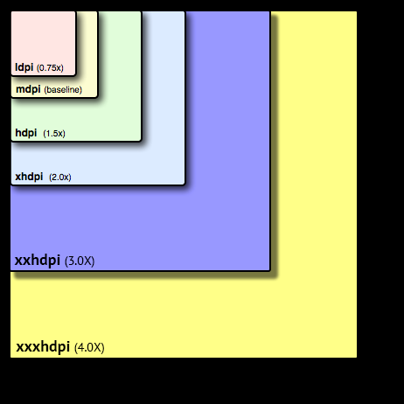
Solution: DPI
DPI (density independent pixel/device independent pixel) is a virtual pixel where we can define dimensions and position.
Android deals how big or small a pixel should appear across different device.
On Android all resources by default are considered for mdpi and scaled for other configurations Whenever we give unit in DP or device independent pixels what happens is for ldpi is multiplied by 0,75 to give us the actual pixels.
This is useful so we don't have to worry about how our drawable will look like with different densities on different screens.

Slide 22
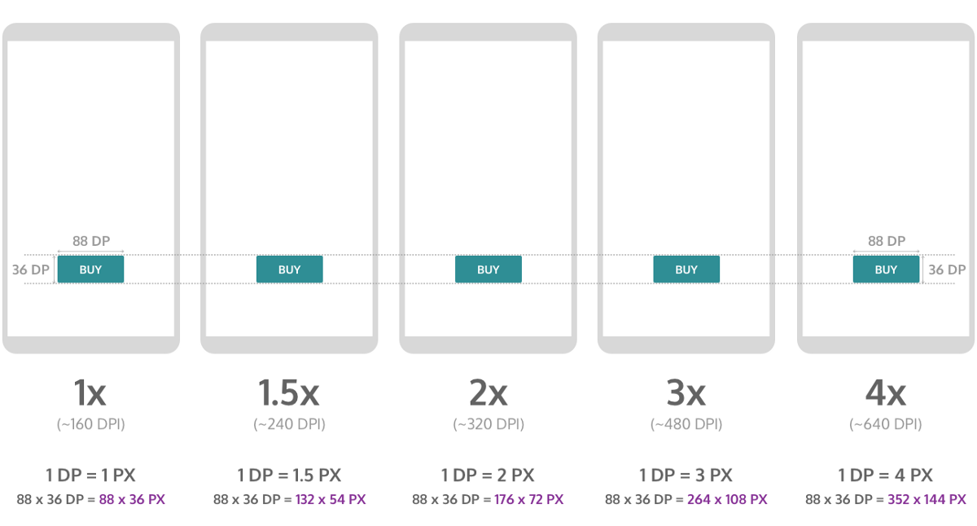
DPI conversion
At runtime, the system convert dp into px. px=dp*(dpi on our device/160)
When our app will be run on different devices, Android automatically applies the scaling factor to that particular device, and it make sure that the size of the user interface control is proportional to the size of the screen.

Slide 23
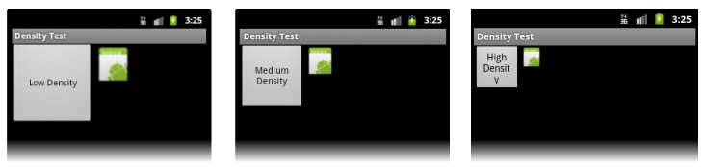
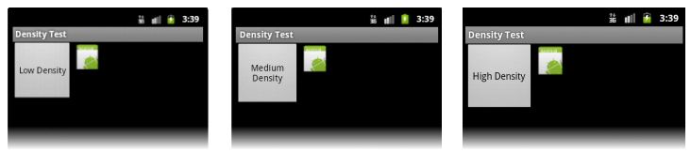
DPI
Without DPI:
With DPI:

Slide 24
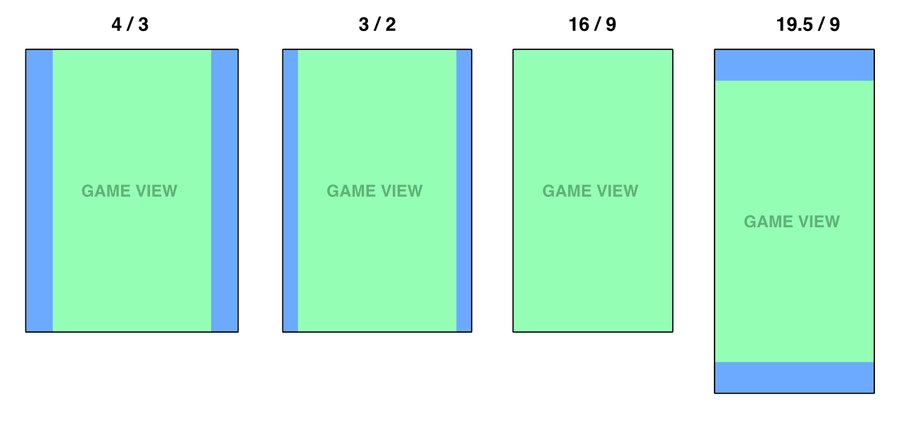
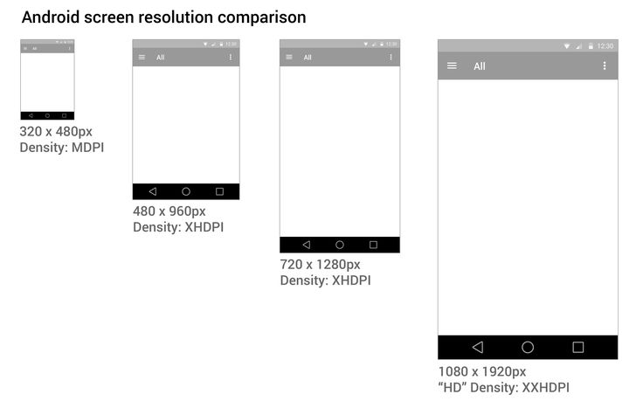
Further aspects
Screen resolution: number of pixels on the screen. In our developing we don’t work with screen resolution because it varies heavily in base of which device we use. We work only with screen size and screen density for cross device support.
Aspect ratio: ratio between width/height can be landscape or portrait.

Slide 25
Unit of measure
So, when we talk about screens, we can have 6 units of measurement, but we do are not suppose use physical units:
mm: millimeters ✘
in: inch ✘
pt: 1/72 of inch✘
dp: based on 160 dpi screen and scaled appropriately for other devices ✓
sp: for fonts based on user font preference ✓
px: base on physical screen size. ✘

Slide 26
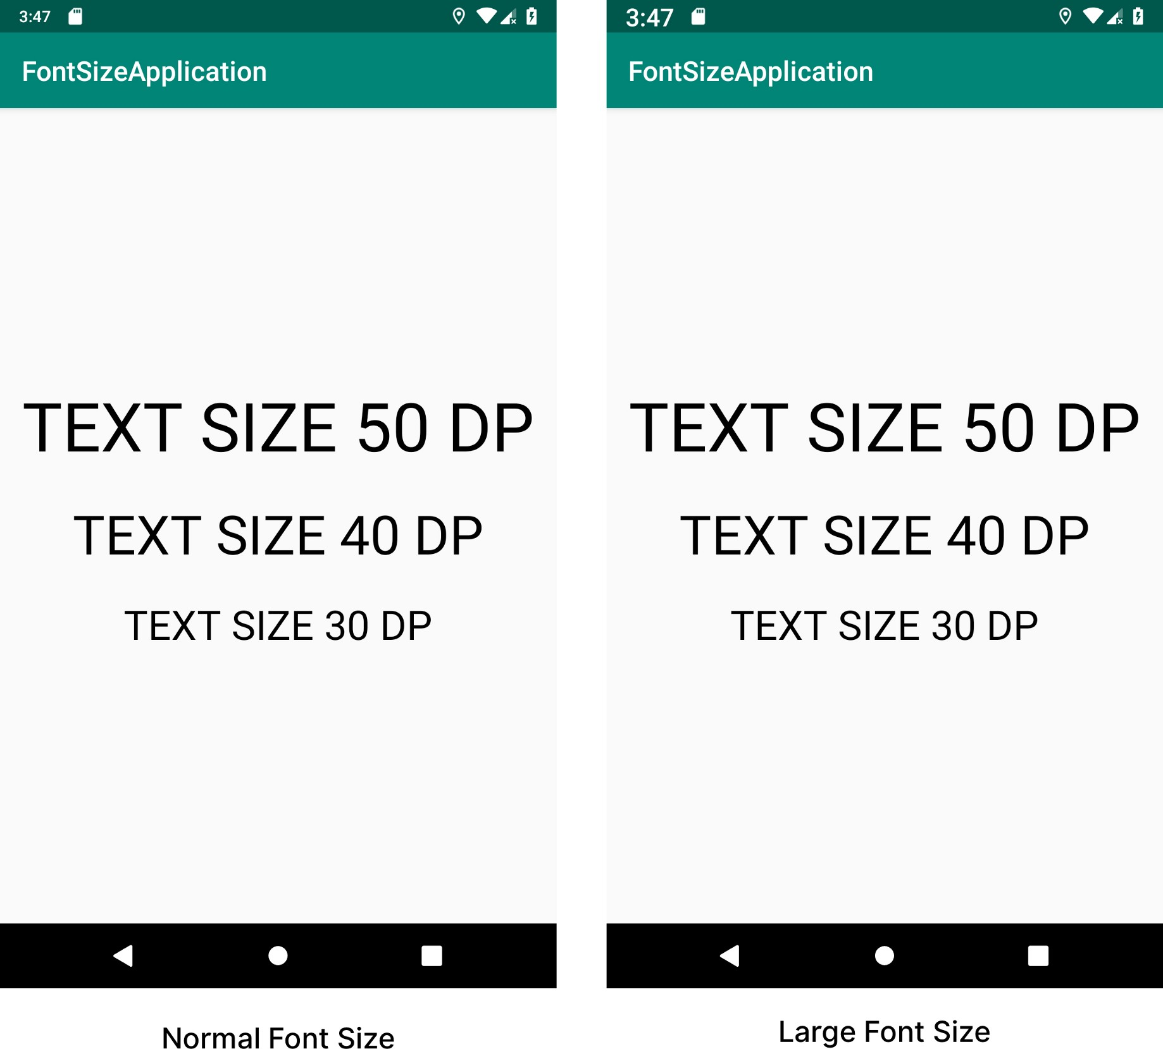
Scaled Pixel
Scaled pixel (sp) are virtual pixel according to density and user font preferences, is the same concept of DPI for fonts.
Whenever we using font, we want to be sure that it will be the same in proportion across different screen sizes, devices, densities sp are responsible to do it.
Morality:
Use dpi for normal sizes such as dimensions: wide of Button ,TextView.
Use sp only for fonts.

Slide 27
View & ViewGroup

Slide 28
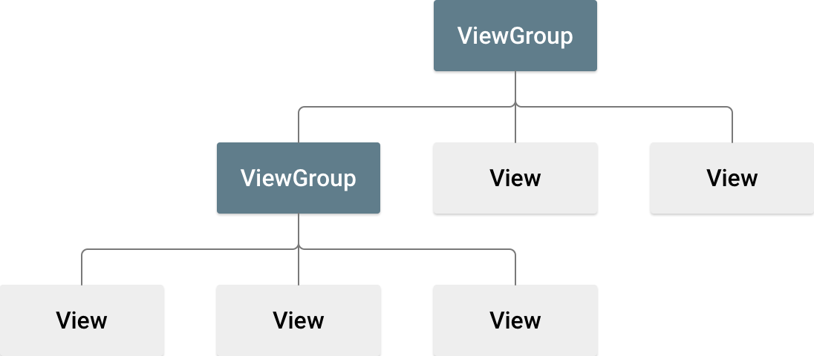
View & ViewGroup

Slide 29
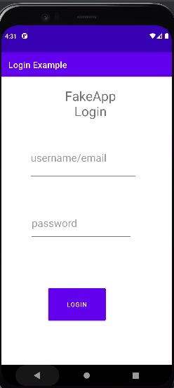
View & ViewGroup
View: all elements in the layout are built using a hierarchy of View and ViewGroup objects. A view is an object that takes rectangular area on the screen and is responsible for handling events in that area ex: button is a View, when is hit is respond in a way.
ViewGroup: An object that surrounds the view and is invisible and is responsible for holding Views in a certain design, a single ViewGroup can contains other ViewGroup. We can consider it as something that arranging other element that displays information.
Activity
ViewGroup
View

Slide 30
Linear Layout

Slide 31
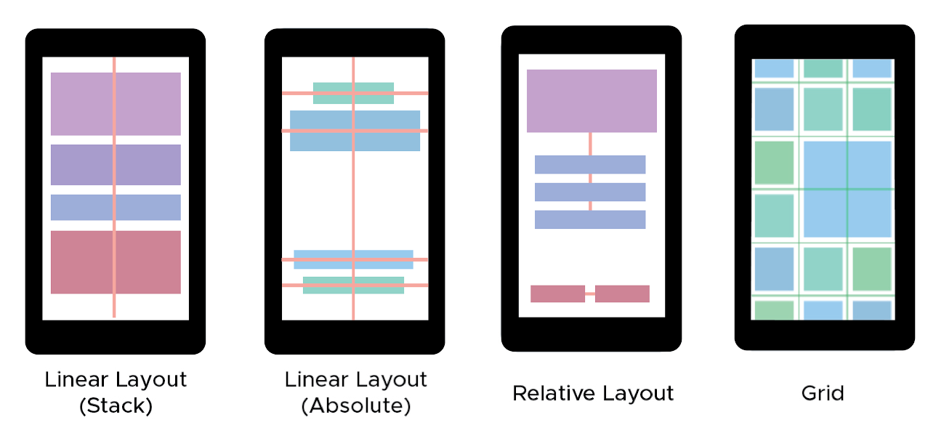
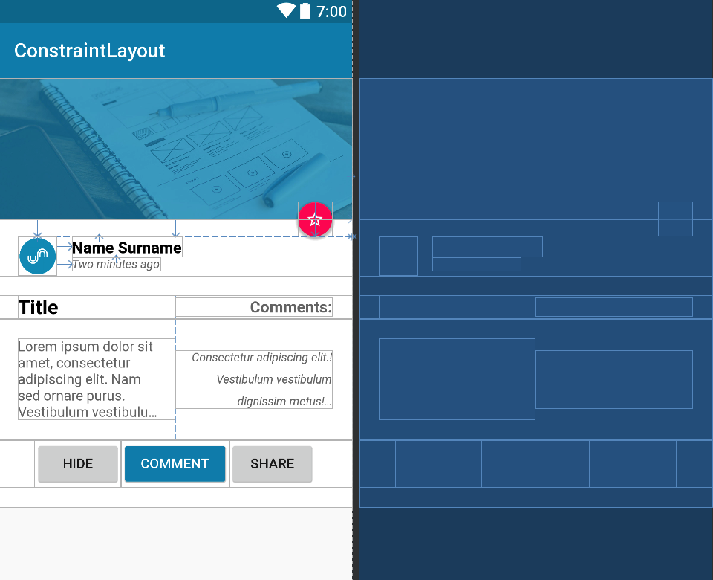
Layout
A layout defines the structure for a user interface in your app, such as in an activity. As we saw on Swing, we can have different layout such as: linear layout, relative layout, grid layout and constraint layout

Slide 32
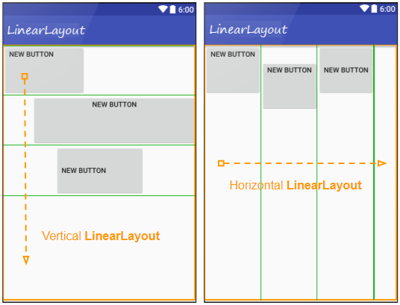
Linear Layout
Contains a set of elements that distributes sequentially from top to bottom (if defined with vertical orientation) or from left to right (if it has horizontal orientation, the default value). It is a very simple and rather natural layout for smartphone and tablet displays. Is responsible from placing the view side by side along different column and same row.
Note: layouts can contain one or more layouts

Slide 33
Create a Linear Layout
In our activity_name.xml open tag <LinearLayout> </LinearLayout>,which said to Android:
who is the root of the entire view structure.
who should be the object responsible for managing all the elements inside it.
When we define our UI appearance in XML, we always have a ViewGroup inside which all the other Views and ViewGroups are placed. The main ViewGroup is called View hierarchy root.
Every XML definition in Android for appearance requires the mentioning of the root.
<LinearLayout>
</LinearLayout>

Slide 34
Create a Linear Layout
Indicate the namespace where is coming from (automatically defined) is a URL.
Specify Layout dimension:
match_parent: takes all the available space.
wrap_content: takes only as much space as needed by content.
we must occupy the maximum space of screen.
Set orientation
<LinearLayout xmlns:android=http://schemas.android.com/apk/res/android”
xmlns:app="http://schemas.android.com/apk/res-auto" xmlns:tools=“http://schemas.android.com/tools”
android:layout_width="match_parent" android:layout_height="match_parent“
android:orientation="vertical"
/>
</LinearLayout>

Slide 35
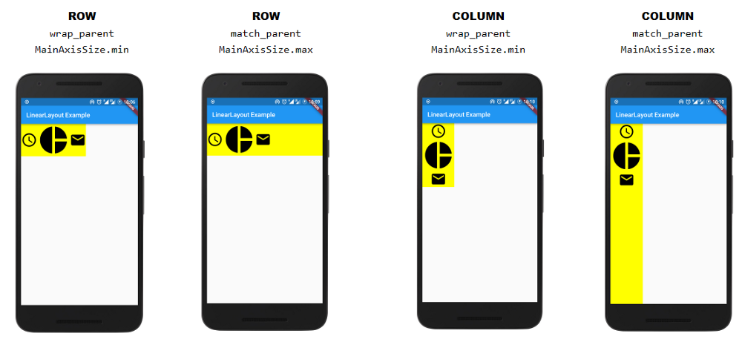
Comparison
match_parent: Object can take space as much as they want inside column or row.
wrap_content: Object take just essential
space to be saw on the screen inside column or row.

Slide 36
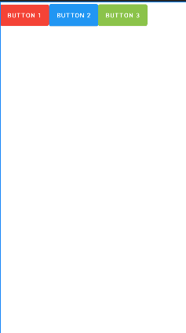
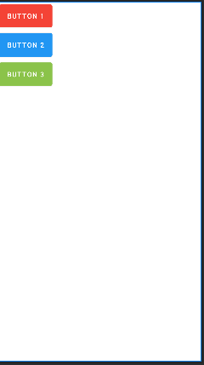
Create a Linear Layout
<LinearLayout xmlns:android="http://schemas.android.com/apk/res/android" xmlns:app="http://schemas.android.com/apk/res-auto" xmlns:tools="http://schemas.android.com/tools" android:layout_width="match_parent" android:layout_height="match_parent" android:orientation="vertical" tools:context=".HomeActivity"> <EditText android:id="@+id/editText“
android:layout_width="133dp" android:layout_height=“match_parent"
……
/> <Button android:id="@+id/loginButton“
android:layout_width=“33dp" android:layout_height=“match_parent"
….. /> <TextView android:id="@+id/textView“
android:layout_width=“wrap_content" android:layout_height=“68dp"
……. /> </LinearLayout>
specify the view, in terms of width and height.
Linear Layout support to way to arrange object:
horizontal: everything is going to come one near each other
vertical: everything is below each other.

Slide 37
Attributes

Slide 38
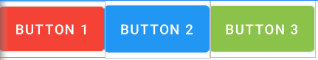
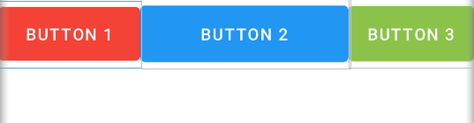
layout_weight
Each view has different attributes that can be used or not depending on the layout chosen. A supported attribute for the Linear Layout is the layout_weight.
This attribute assigns an "importance" value to a view in terms of how much space it should occupy on the screen. A larger weight value allows it to expand to fill any remaining space in the parent view. Child views can specify a weight value, and then any remaining space in the view group is assigned to children in the proportion of their declared weight. By default, layout_weight is zero.
Without
<Button android:id="@+id/Button1" android:layout_weight="2" android:text="Button 1" /> <Button android:id="@+id/Button2
android:layout_weight="10" android:text="Button 2" /> <Button
android:id="@+id/Button3 android:text="Button 3" />
With

Slide 39
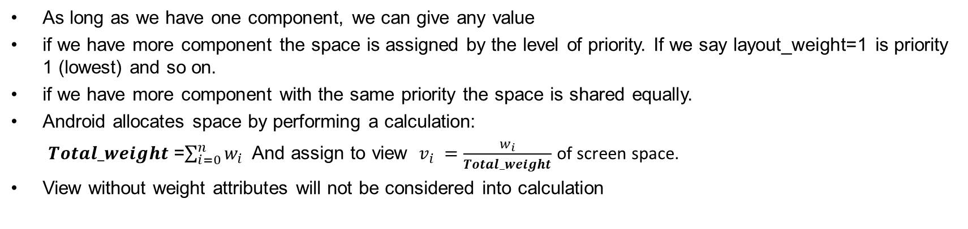
Note
As long as we have one component, we can give any value
if we have more component the space is assigned by the level of priority. If we say layout_weight=1 is priority 1 (lowest) and so on.
if we have more component with the same priority the space is shared equally.
Android allocates space by performing a calculation:
$Total_weight$=$\sum_{i=0}^{n}{w_{i}}$And assign to view $v_{i} =\frac{w_{i}}{Total_weight}$ of screen space.
View without weight attributes will not be considered into calculation
2
10
In our case $Total_weight$=12, Button1 takes $\frac{2}{12}$ of screen space , instead Button2 takes $\frac{10}{12}$of screen space, Button3 not considered.

Slide 40
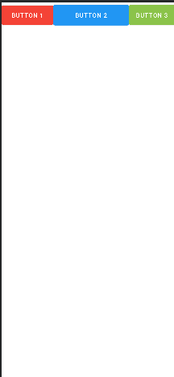
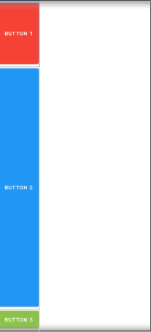
Note
When layout_weight is used, other attributes became redundant :
layout_height=layout_weight , in horizontal linear_layout.
layout_width=layout_weight, in vertical linear_layout.
For that reason we must set layout_width/ layout_height= 0dp to avoid that Android perform other calculation since we use layout_weight.
Layout_weight depends on which orientation of linear layout we are working with:
Horizontal linear layout, modify view’s width
Vertical linear layout, modify view’s height

Slide 41
layout_gravity
Control where a View should appear inside its parent, if the view and the parent are both the same size, we not aspect to see any changes.
Gravity main xml values are:
left: Push object to the left of its container, not changing its size.
right: Push object to the right of its container, not changing its size.
center: Place the object in the center of its container in both the vertical and horizontal axis, not changing its size.
top : Push object to the top of its container, not changing its size.
bottom: Push object to the bottom of its container, not changing its size.
Also we can use a mix of them such as: top|left.
Not any values works for all layouts, instead having errors we do not see any changing on the screen.

Slide 42
layout_gravity: Horizontal
Element can be arranged on top, bottom in the same column. For a horizontal linear layout, layout_gravity values do not change columns.
Values | Applicable?
layout_gravity=”bottom” | ✓
layout_gravity=”top” | ✓
layout_gravity=”center” | ✓
layout_gravity=”center_vertical” | ✓ at column, not on the center of the screen.
layout_gravity=”center_horizontal” | ✘ Not supported change column, nothing error is showed, after that View came back to the default location.

Slide 43
layout_gravity: Vertical
Object are allowed to move in the same row, but not change column.
Values | Applicable?
layout_gravity=”bottom” | ✘
layout_gravity=”top” | ✘
layout_gravity=”center” | ✘
layout_gravity=”center_vertical” | ✘
layout_gravity=”center_horizontal” | ✓

Slide 44
gravity
Control where the contents of the View should appear inside the View ex: the text of textView. The view must be bigger than the content inside to see the effect of it, if the View is wrap_content is height and width we never will see any effect.
Values are:
android:gravity=”right”
android:gravity=”left”
android:gravity=”center_vertical”
android:gravity=”center”
android:gravity=”bottom|right”
Left
Top
Center_horizontal
Right
Center_vertical
Center
Bottom
Notes:
Left

Slide 45
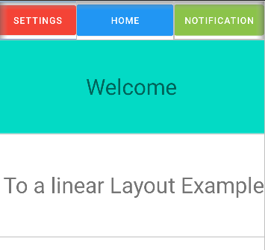
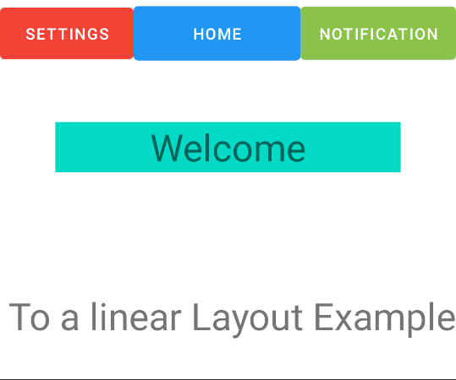
layout_margin & padding
layout_margin: margin is the space outside the view between itself and its container.
padding: space inside the view between its boundaries and its content.
The Welcome TextView has a padding of 50dp which correspond to its height.
The Welcome TextView is distant from all other 50dp views always remaining within its linear layout line.

Slide 46
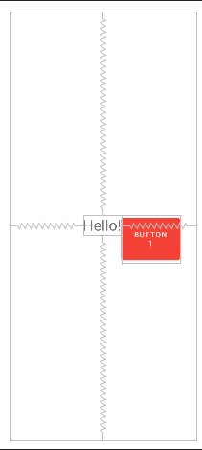
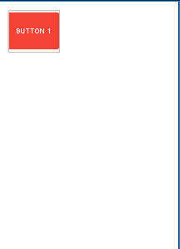
Note
If we have a single View, Android padding applied to the parent looks the same as the Android margin applied to the child.
We can apply both the attributes
<RelativeLayout android:layout_width="match_parent" android:layout_height="match_parent" android:orientation="vertical" android:padding="20dp" > <Button android:id="@+id/Button1" android:layout_width="117dp" android:layout_height="96dp" android:backgroundTint="#F44336" android:text="Button 1" android:textSize="15sp" /> </RelativeLayout>
<RelativeLayout android:layout_width="match_parent" android:layout_height="match_parent" android:layout_margin="20dp" android:orientation="vertical" > <Button android:id="@+id/Button1" android:text="Button 1" android:padding="20dp" android:textSize="15sp" /> </RelativeLayout>
<RelativeLayout android:layout_width="match_parent" android:layout_height="match_parent" android:orientation="vertical" > <Button android:id="@+id/Button1" android:layout_width="117dp" android:layout_height="96dp" android:backgroundTint="#F44336" android:layout_margin="20dp" android:text="Button 1" android:textSize="15sp" /> </RelativeLayout>

Slide 47
RelativeLayout

